Slide 1

Company Overview of Microsoft Corporation

Slide 2
INTRODUCTION
Al Noman Robin
ROLL: 19
BATCH: D-91
REG NO: CS-D-91-23-124595
COURSE: Business Strategy Management
Date: 17.07.2025

Slide 3
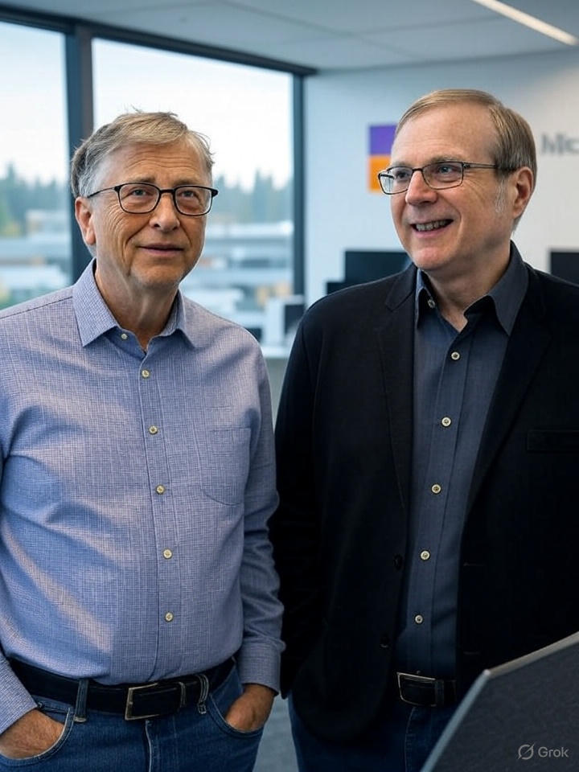
3
Introduction to Microsoft
Founded in 1975 by Bill Gates and Paul Allen.
Headquartered in Redmond, Washington, USA.
Microsoft is a global technology company known for software, hardware, and services.
Key Departments: HR, IT, Finance, R&D, Marketing, Sales, Cloud & AI.

Slide 4

Mission, Vision, and Objectives
4
Mission: To empower every person and organization on the planet to achieve more.
Vision: To help people and businesses realize their full potential.
Objectives: Lead in cloud computing, AI integration, and productivity software.

Slide 5
Products and Services
Product-Oriented: Windows OS, Microsoft Office, Surface devices, Xbox.
Service-Oriented: Microsoft Azure, Office 365, LinkedIn, GitHub.
Cloud and enterprise services are major revenue drivers.
Combines software, cloud, and hardware to offer integrated experiences.

Slide 6
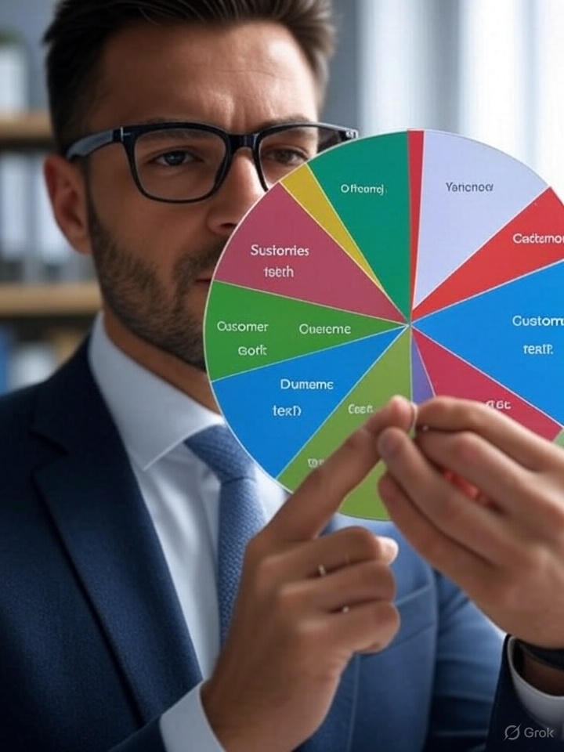
Customer Segmentation & Target Market
Demographic: Businesses, developers, students, gamers, enterprises.
Psychographic: Tech users, productivity seekers, cloud developers.
Target Market: Global businesses and individuals across industries.
Channels: Online stores, resellers, enterprise contracts, education sector.

Slide 7
Marketing & Branding Strategy
Value Proposition: Reliable, innovative software and cloud services.
Branding: Known for productivity, trust, and enterprise-grade tools.
Marketing Channels: Digital ads, global partnerships, tech events, demos.
Brand Slogans: 'Empowering us all', 'Be what's next'.

Slide 8
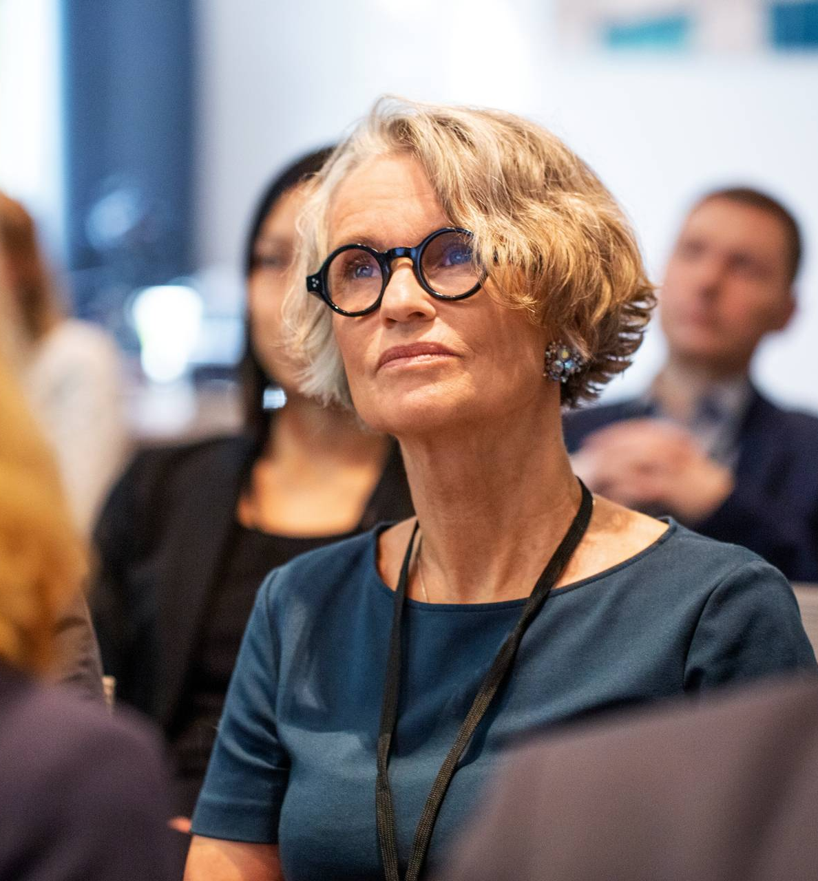
Innovation Strategy & SWOT Analysis
Innovation: Heavy R&D in AI (Copilot), cloud (Azure), productivity tools.
Strength: Dominant OS market share, cloud leadership, trusted brand.
Weakness: Dependence on enterprise clients, some failed hardware (e.g. Lumia).
Opportunity: Expand AI integration, gaming (Activision), hybrid work tech.
Threat: Competition from Google, Amazon, regulatory scrutiny.

Slide 9

Thank you
Al Noman Robin
01774 -139359
robinalnoman@gmail.com

